Slide 1

Video Classification with a CNN-RNN Architecture
Presented By-
Divyansh Gadwal- 2104107017

Slide 2
Topics to be covered
Overview of Video Classification
Steps to build our own Video Classification model
Video Classification dataset
Training our Video Classification Model
Evaluating our Video Classification Model

Slide 3
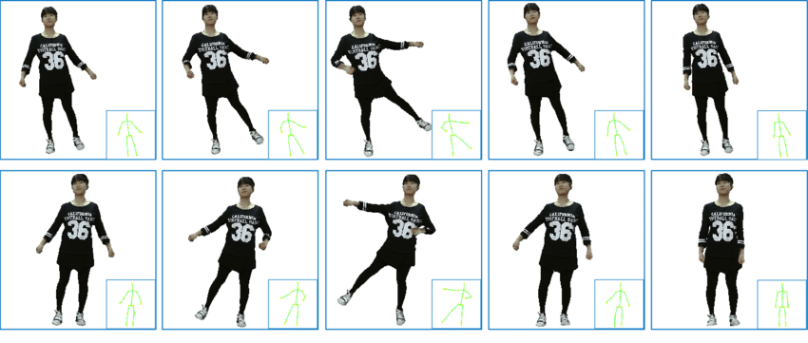
What is a video ?

Slide 4
Image classification
Take images
Extracting its features using Convolutional Neural Networks (CNN).
Classify the image based on those extracted features.

Slide 5
Video Classification
We first extract frames from the given video
We use feature extractors (like convolutional neural networks or CNNs) to extract features from all the frames.
Then classify every frame based on these extracted features.

Slide 6
Human Activity Recognition
Classifying the action performed by human

Slide 7

How Human Activity Recognition is different from a normal classification task?

Slide 8
With the help of Video Classification models, we can solve the problem of Human Activity Recognition

Slide 9
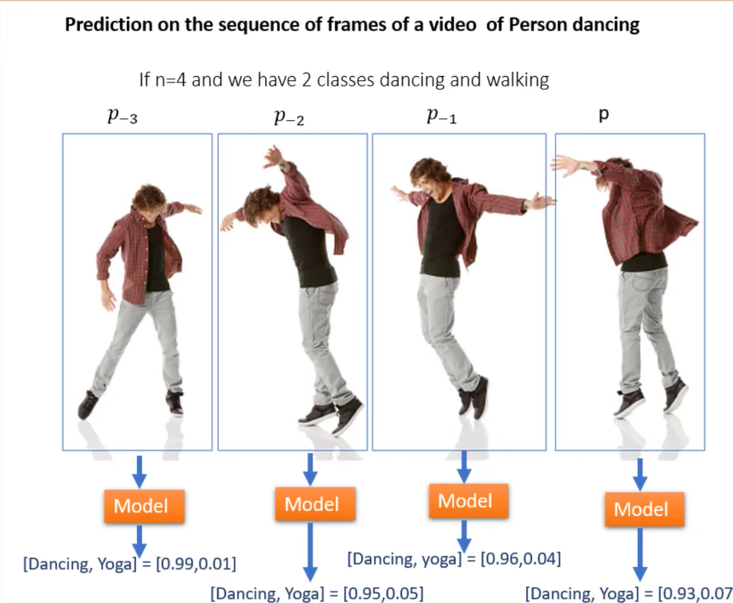

Slide 10
Practical Implementation on custom dataset

